Slide 1
Enhanced Energy Efficiency in Indian Data Centre
Innovative cooling technologies for densely occupied loads
Prakash Lohia | Reliance Industries Ltd

Slide 2
Agenda
Definition of densely populated Data Centre
Innovative cooling for location based environment
Amsterdam ( Netherlands ) Innovative Data Centre Cooling
Innovative Cooling Concepts

Slide 3
Definition of densely populated Data Centre

Slide 4
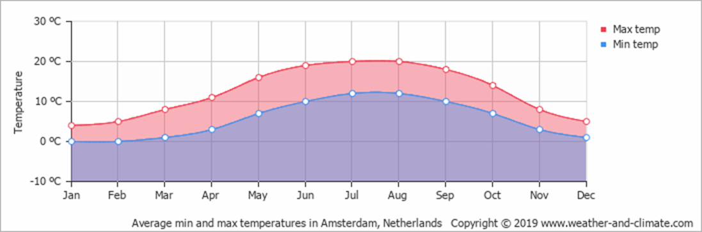
Innovative cooling for location based environment
Amsterdam (Netherlands) environment condition
Average day and night temperatures
The average minimum and maximum temperatures over the year.
Winter ( December to February) : 2 to 6 degree C
Spring (March to May) : 10-17 degree C
Summer (June to August): 20-25 degree C
Autumn (September to December): 7.6 -13.6 degree C
The average temperature in the Netherlands during autumn is 10.6 degree C.
Generally, autumn is the wettest season in the Netherlands, with November being the month with the
most precipitation.
For two to three days temperature goes 30 - 32 degree C

Slide 5
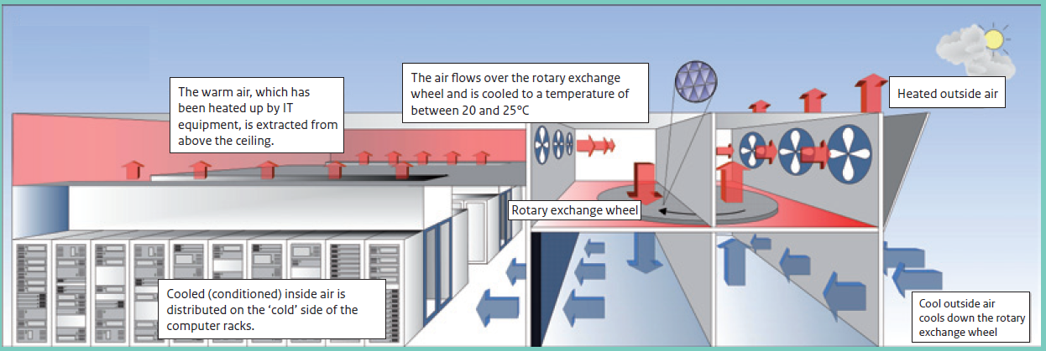
Amsterdam Data Centre cooled by rotary exchange wheel
The rotary exchange wheel

Slide 6
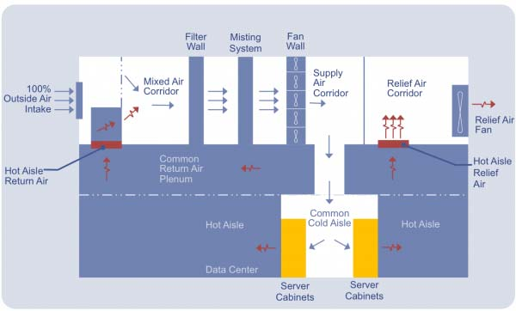
Cooling Data Centre with evaporative cooling
In the Netherlands the climate is cold enough to be able to provide the data centre with the necessary cooling on most days of the year. During the average 350 hours a year - out of an annual total of 8760 hours - when it is too warm to do this, that outside air is given additional cooling.
This is done using the StatiqCooling heat exchanger which cools the air by evaporating water, and the water vapour which is thereby released is fed outside immediately so that the data centre does not become too humid.
The heat from the data centre is reused and mixed with air drawn directly from outside to achieve the desired cooling temperature.
In the winter we used that processed air to humidify the cold air. This concept from Datacenter Infra Solutions offers a solution which is sustainable, available and highly lucrative throughout the year in accordance with the ARSHRAE standard.
Evaporative cooling technology

Slide 7
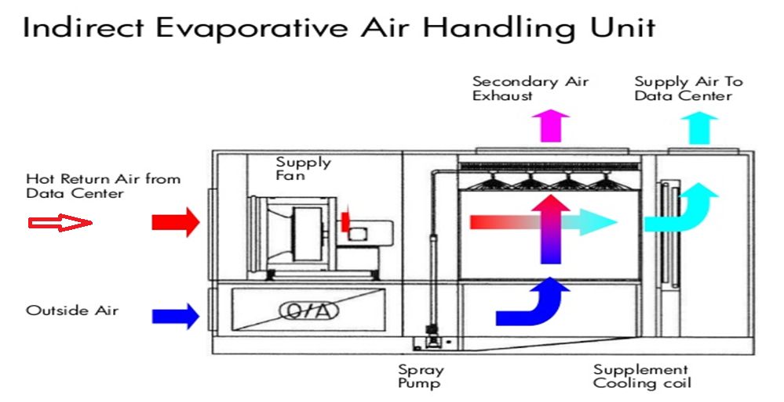
Cooling Data Centre with Indirect evaporative Cooling
Climate technology from Menerga
What Menerga’s technology makes so special is that the outside air and recirculation air remain completely separated from each other. This keeps the oxygen content in the room to a minimum.
In addition, extra and therefore more expensive humidification is not required during the winter.
If the temperature in the data centre needs to be lower than 24°C, a small refrigerant cooling circuit or a cold water heat exchanger can be build in the unit to complete the required capacity.

Slide 8
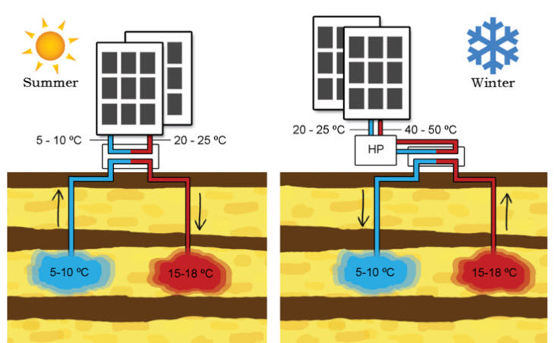
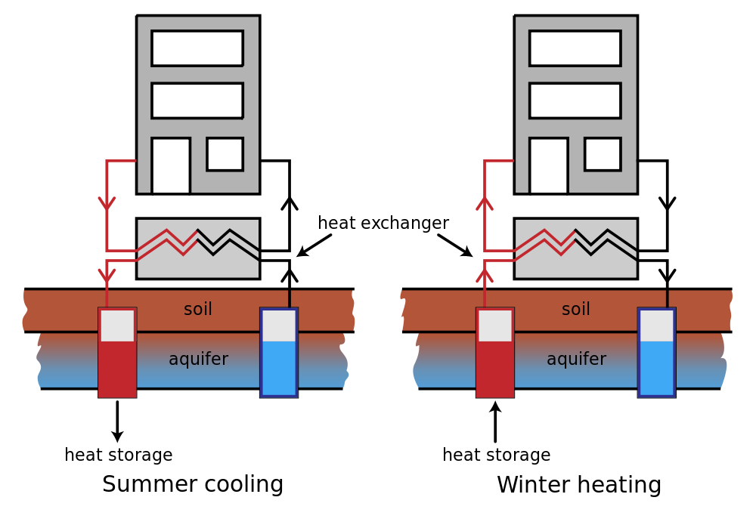
Cooling Data Centre with Aquifer Thermal Energy Storage (ATES)
Aquifer Thermal Energy Storage(ATES) :
This can be achieved with an energy storage system, which accumulates the surplus of free cooling in the winter in an underground storage facility so that it can be delivered when high temperatures occur in the summer.
This concept makes it possible to achieve an Energy Usage Efficiency (EUE) value of between 1.1 and 1.2.
Emergency cooling as well
The main advantage of an ATES system is that it can also act as a preferential emergency cooling system at any time of the year. This is because cooling can always take place based on the natural temperature in the underground storage facility. Furthermore, this type of emergency cooling also requires significantly less emergency power than traditional chillers. Start-up is also much faster.

Slide 9
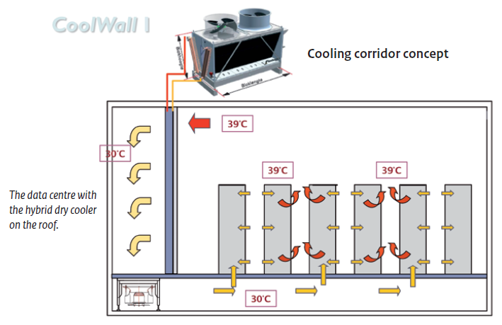
Data Centre cooling with dry cooler

Slide 10
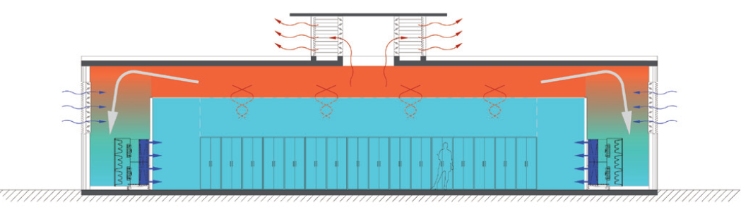
Data Centre cooling by low speed ventilation

Slide 11
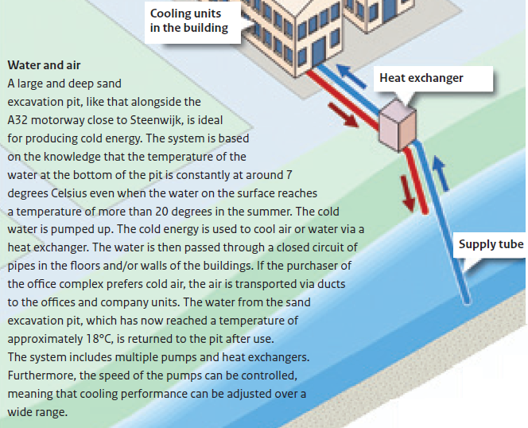
Cooling Data Centre with Lake source Cooling
Lake Source Cooling (LSC))

Slide 12
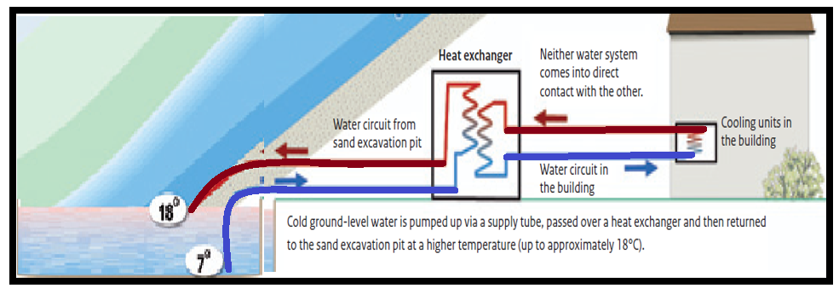
Cooling Data Centre with Lake source cooling
Lake Source Cooling (LSC)

Slide 13
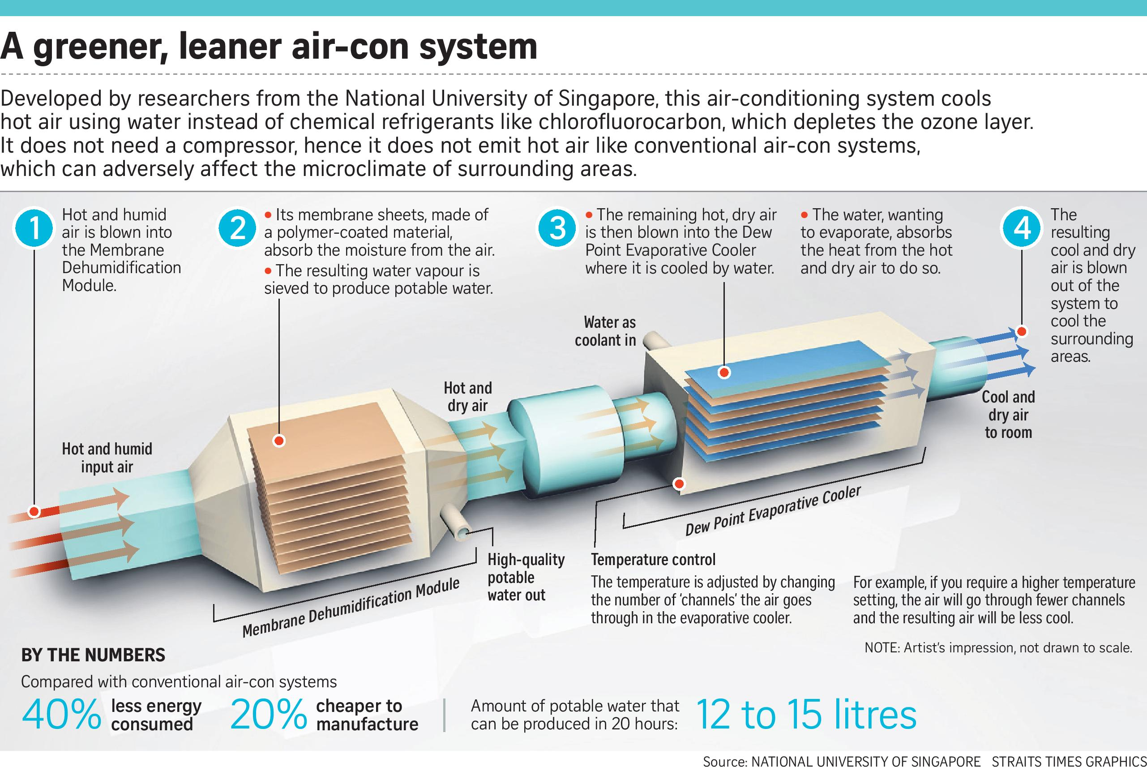
New Concepts
Membrane based, water refrigerant based, air conditioner

Slide 14
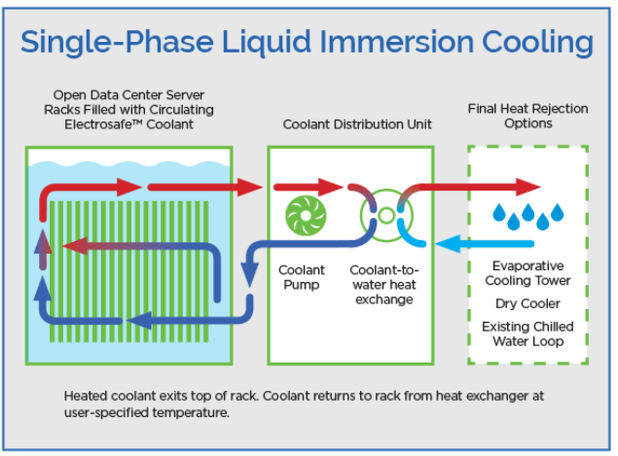
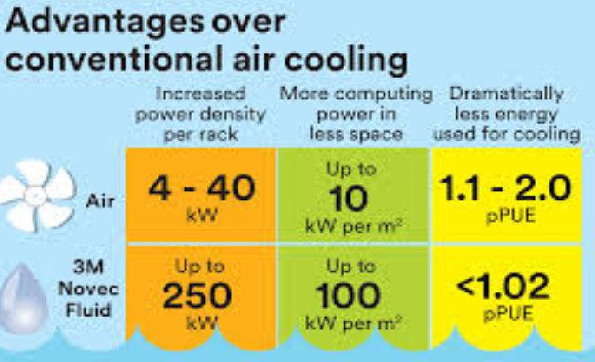
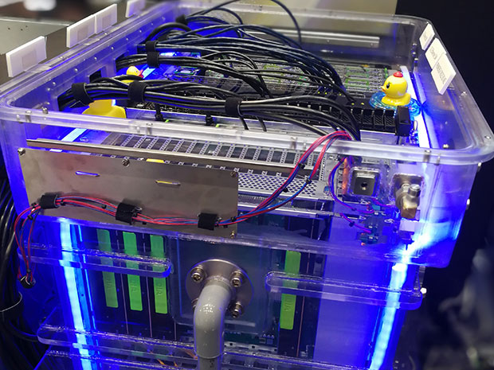
New Concepts
Liquid Immersion Cooling:

Slide 15
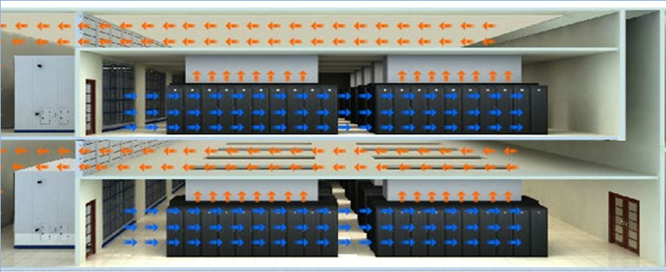
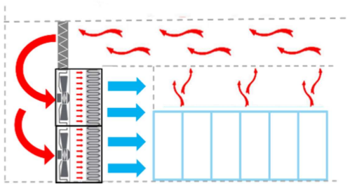
New Concepts
FAN WALL UNIT:
No requirement for false floor and floor grilles
Low air velocity and uniform air temperature within the room
Constant Supply Air temperature till top level of server rack
Lower pressure drop across FWU, leading to lower power consumption leading to better PUE

Slide 16
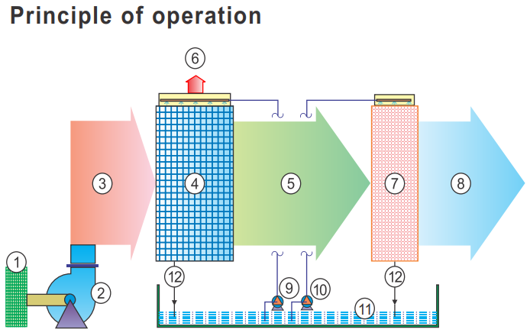
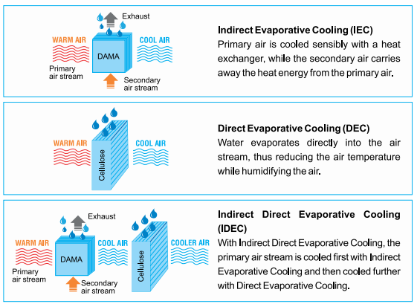
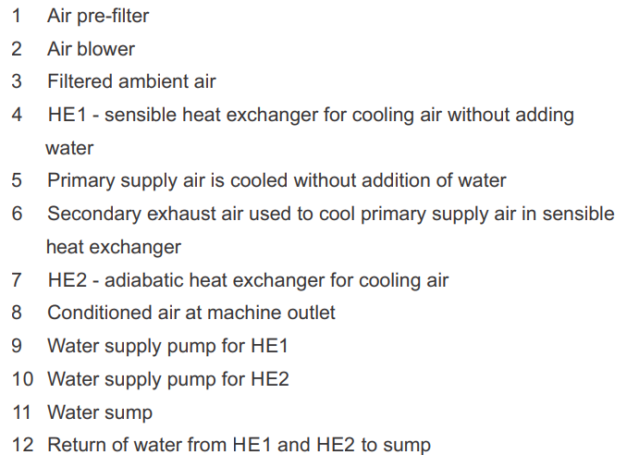
New Concepts
Two stage evaporative cooling /
Indirect Direct Evaporative Cooling

Slide 17
Thank You
Email:Prakash.lohia@ril.com

