Slide 1




Digital Launch of Case Study:
Infosys Data Center Bangalore
“Innovation in Energy Efficiency in Data Centers”
CII - Indian Green Building Council and Lawrence Berkeley National Laboratory (LBNL) USA
22 October 2020
Notes:
1

Slide 2


Digital Launch of Case Study:
Infosys Data Center Bangalore
“Innovation in Energy Efficiency in Data Centers”

Slide 3
Launch of Case Study:
Infosys Data Center Bangalore
“Innovation in Energy Efficiency in Data Centers”

Slide 4
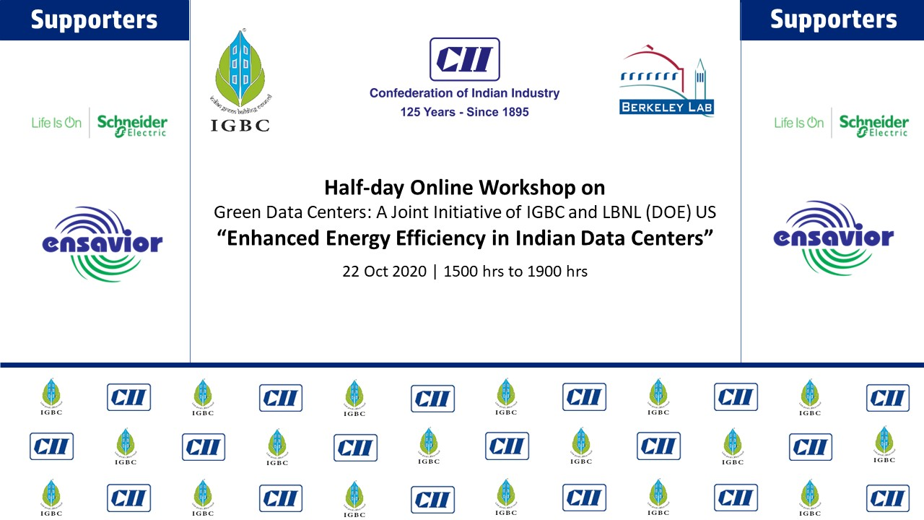

Slide 5

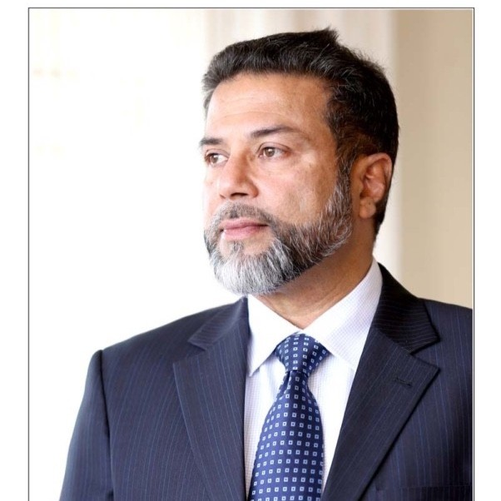
Mr Syed Mohammed Beary
Chairman, IGBC Bangalore Chapter
& MD Bearys Group
Mr Beary founded the Bearys Group in 1981 and has been leading the Green Building movement in India from Karnataka.
“Delivering Excellence, Consistently” &‘Triple E’ i.e. ‘Entrepreneurship’, ‘Environment’ and ‘Education’ sums up the spirit & foundation of Bearys Group.
Bearys Group is presently developing several high-profile projects like Data Centres, Lab spaces, R&D Parks and Campus developments in Mumbai, Chennai, Hyderabad and Bangalore among others on a unique Design-Build-Deliver (DBD) model, underpinned by stringent quality, cutting edge technology and speedy delivery.

Slide 6
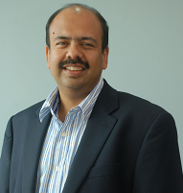
An Electrical Engineer from IIT Bombay and Master’s degree from Columbia University, New York.
An industry veteran with over 20 years of extensive experience in developing Internet backbone infrastructure
His passion and commitment to deliver value to clients is evident in the way he built a customer-focused service organization called Netmagic in Jul98, which now has the backing of NTT, a Fortune 500 company.
Considered a pioneer in the Indian cloud computing space and vision has helped the company become a leader in the Public Cloud services market in India.
During a 6yrs stint in the US, Sharad worked for Unified Network Management Architecture Group at AT&T Bell Labs, the Backbone Engineering Group of NSFNET (ANS) and the Router Systems Development Group of Advantis (IBM Global Network).
He has also helped Merrill Lynch and Bankers Trust design and deploy Wide Area Networks.
Mr Sharad Sanghi
CEO – Global Data Centers and
Cloud Infrastructure (India),
NTT Ltd.

Slide 7
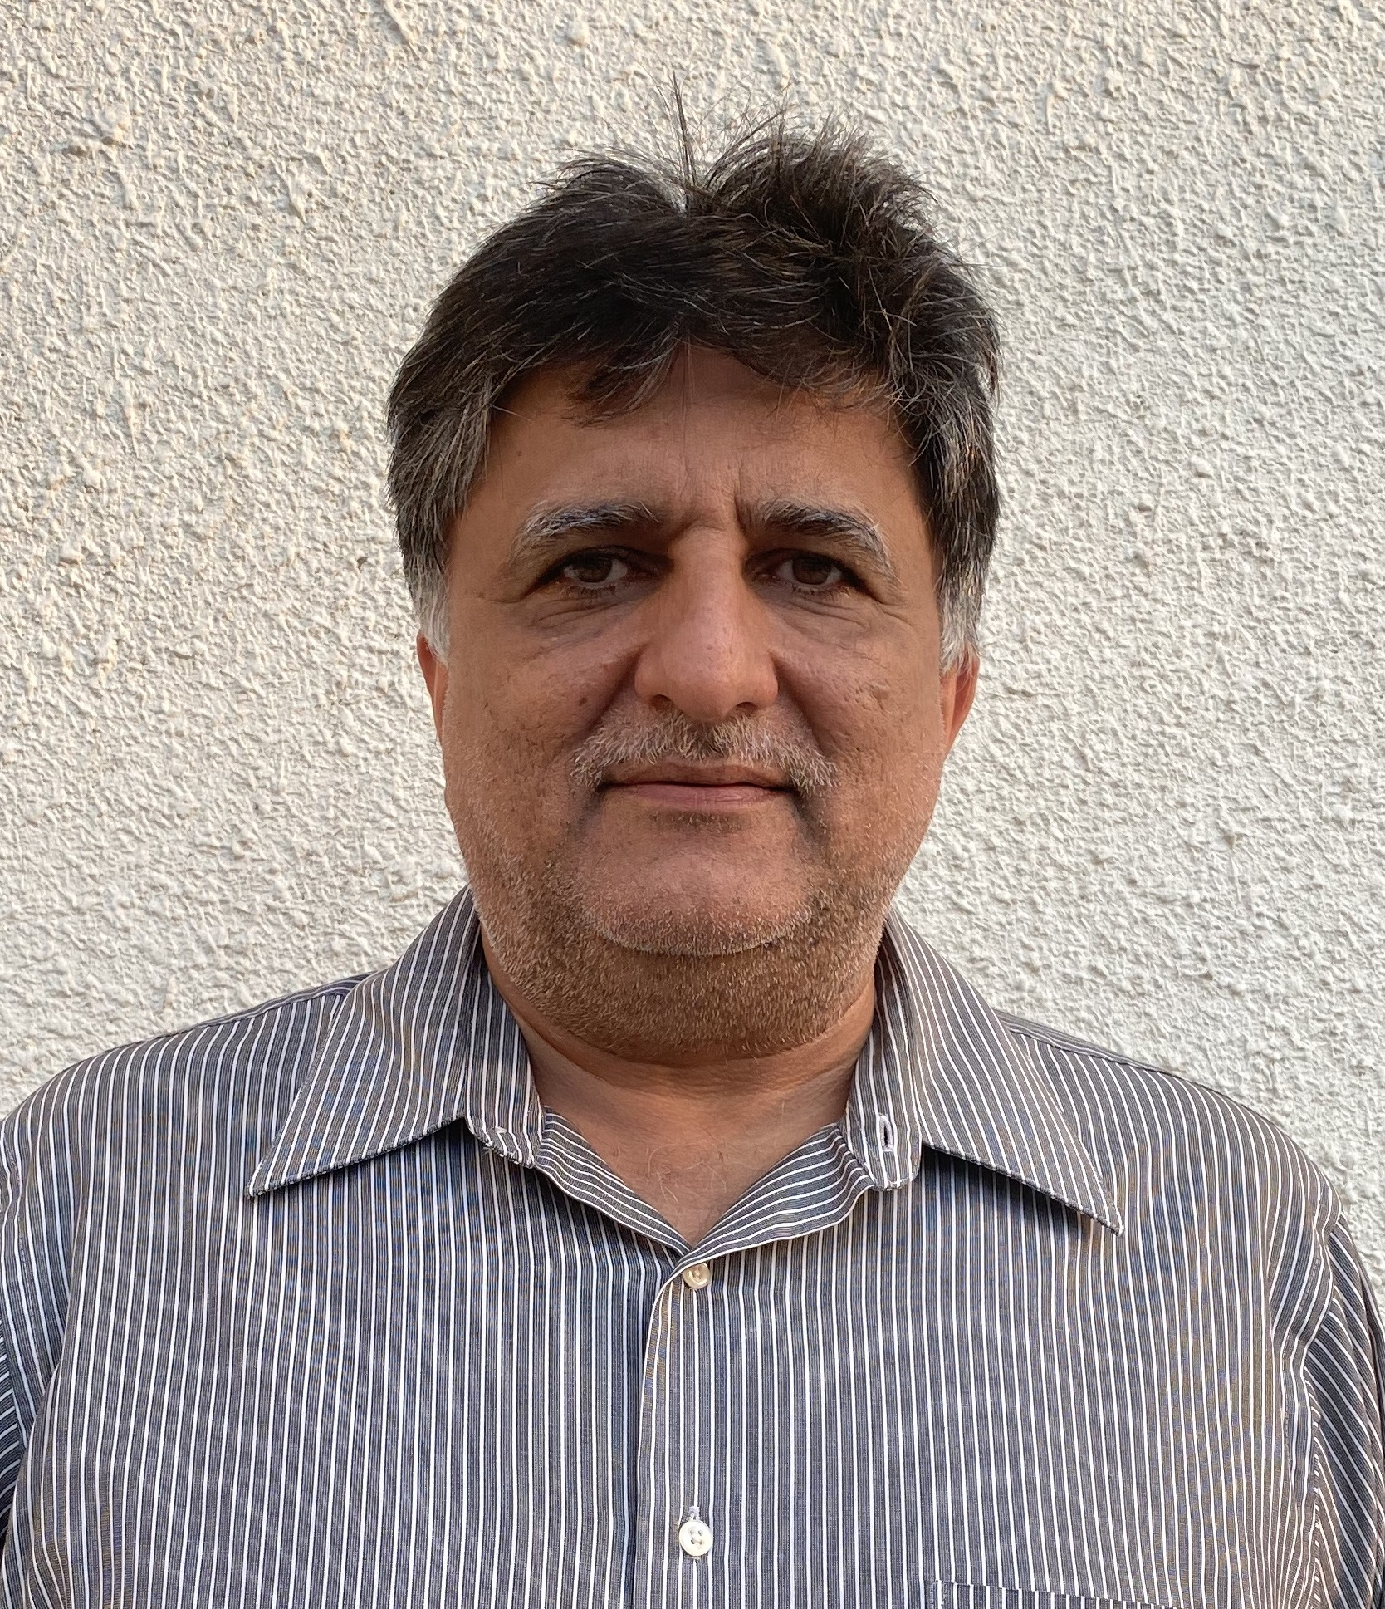
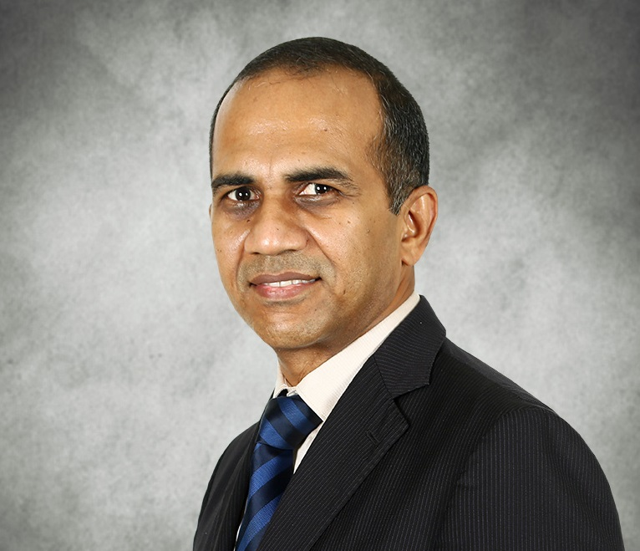
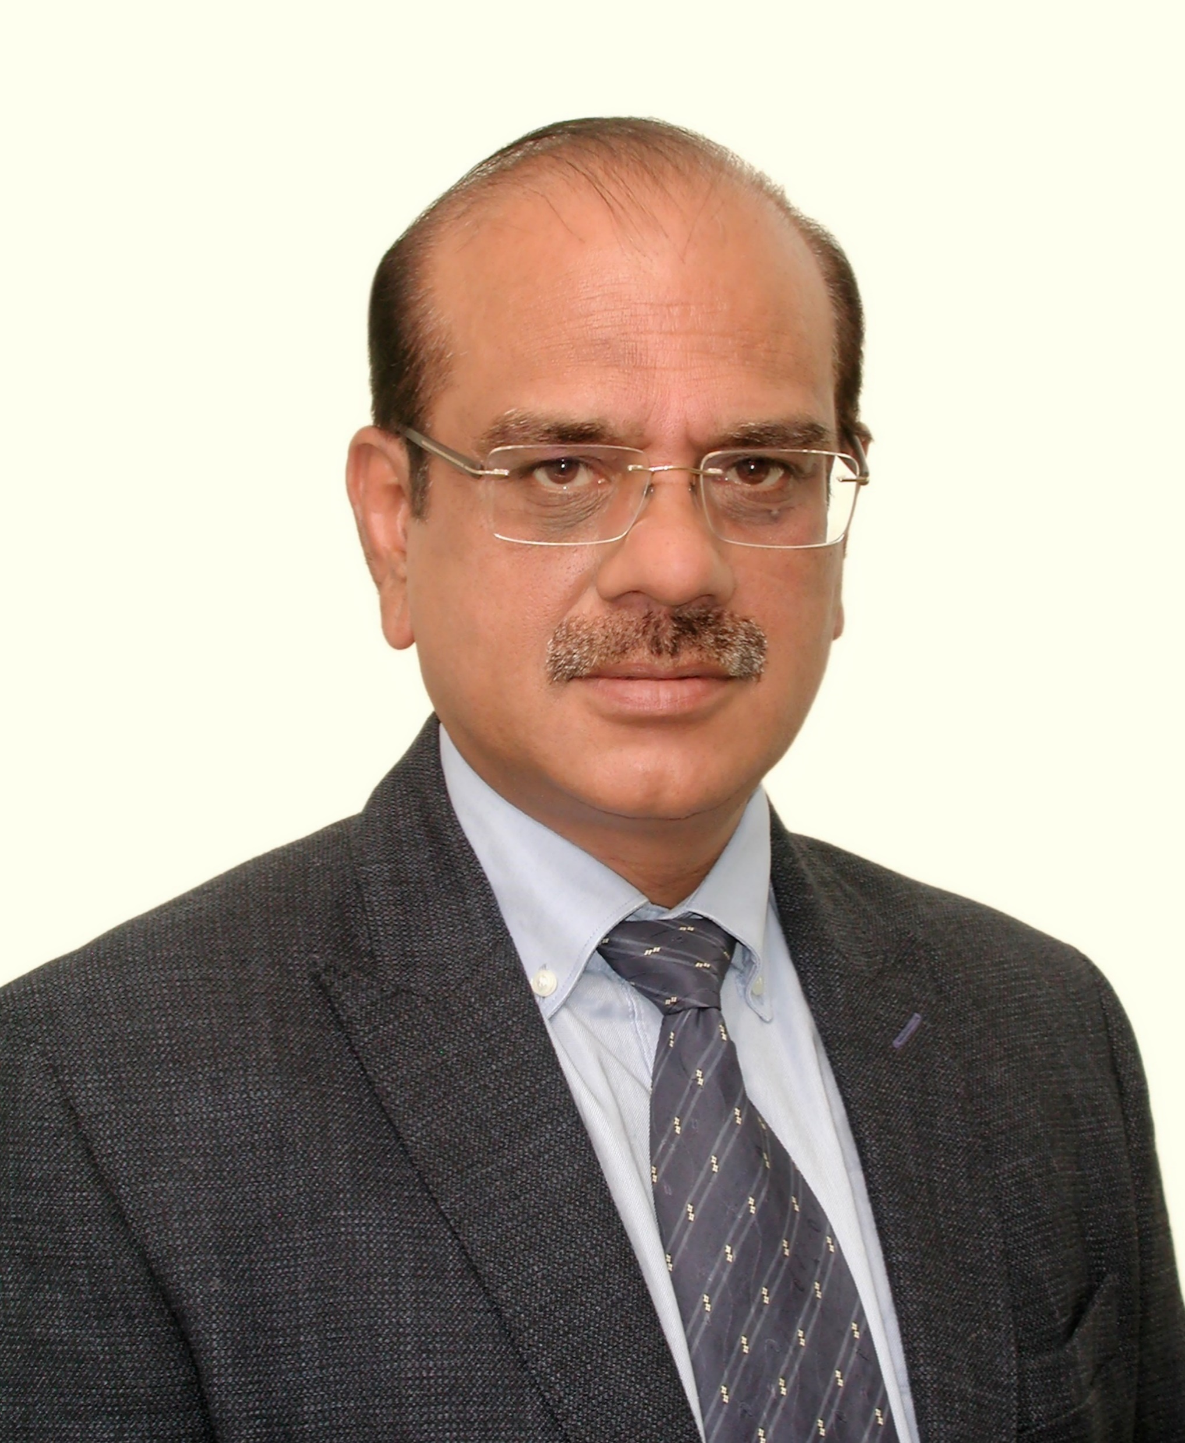
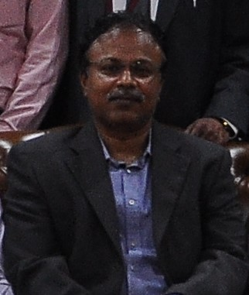
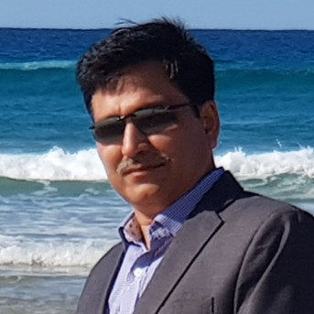
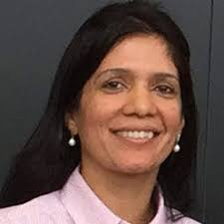
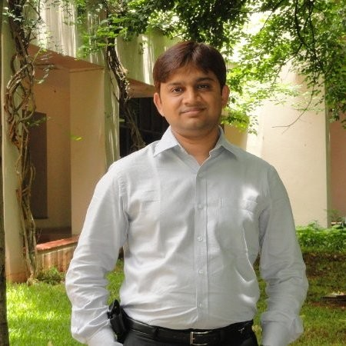
Panel Discussion: Policies, Best Practices and Technological Advancement in Indian Data Centers and Future Growth
Mr Vikram Nagarani
Vice President
Design, Build and Delivery,
STT GDC India
Mr Venkatraman Swaminathan
Vice President—IT Division, Energy Management,
Schneider Electric
Mr Sudhanshu Datt
Director - Data Centers
AECOM India Pvt Ltd.
Mr Rajkumar
Vice President - IT, Infosys
Mr Amit Kakkar
Technical Director
Dept. of Information & Tech, Govt. of Rajasthan
Mrs Shalini Singh
Senior Manager Sustainability,
VMware
Mr Punit Desai
Regional Head
(Smart Spaces), Infosys

Slide 8
Mr Vikram Nagrani
Vice President
Design, Build and Delivery, STT GDC India
With over 25 years of experience spanning in the field of construction, engineering and operations of data centres, Vikram, has developed a reputation for building strong teams and delivering exceptional results in the industry. In his career he has overseen the construction datacentres valued at more than $150 million.
In his current position at STT GDC India is fully leveraging his energy, industry knowledge and leadership skills in the areas of site acquisition, strategy and technical direction, design, construction & deployment, market resource capability, testing, commissioning, documentation and testing

Slide 9

Mr Sudhanshu Datt is a Pioneer in Datacenter infrastructure projects, having built, certified and Operated large size hyper scale Datacenters in India since 2006.
Having 30 plus years of rich experience in Project Management, Infra structure operations, Telecom/IT Infrastructure and Data Centers.
He has been responsible for building diverse set of teams, vendors, across regions and functions for Overall Datacenter deployment and service Operations.
He is currently working with AECOM as sector lead for Data centers & Mission Critical infrastructure.
Mr Shudhanshu Datt
Director – Data Centers, AECOM

Slide 10
Mr Venkatraman Swaminathan
Vice President – IT Division, Energy Management, Schneider Electric
Mr Venkatraman Swaminathan has over 28 years of experience in leading businesses in the Data center arena.
Mr Venkat is highly proficient in Data Center solutions. He brings a wealth of experience in product based solutioning for Mission Critical Customer applications like Data centers, Mobile Switch Centers, Test laboratories etc. He is a Product domain expert for Power Conditioning (UPS), Precision Cooling, Rack Systems and such other Data Center offers.

Slide 11
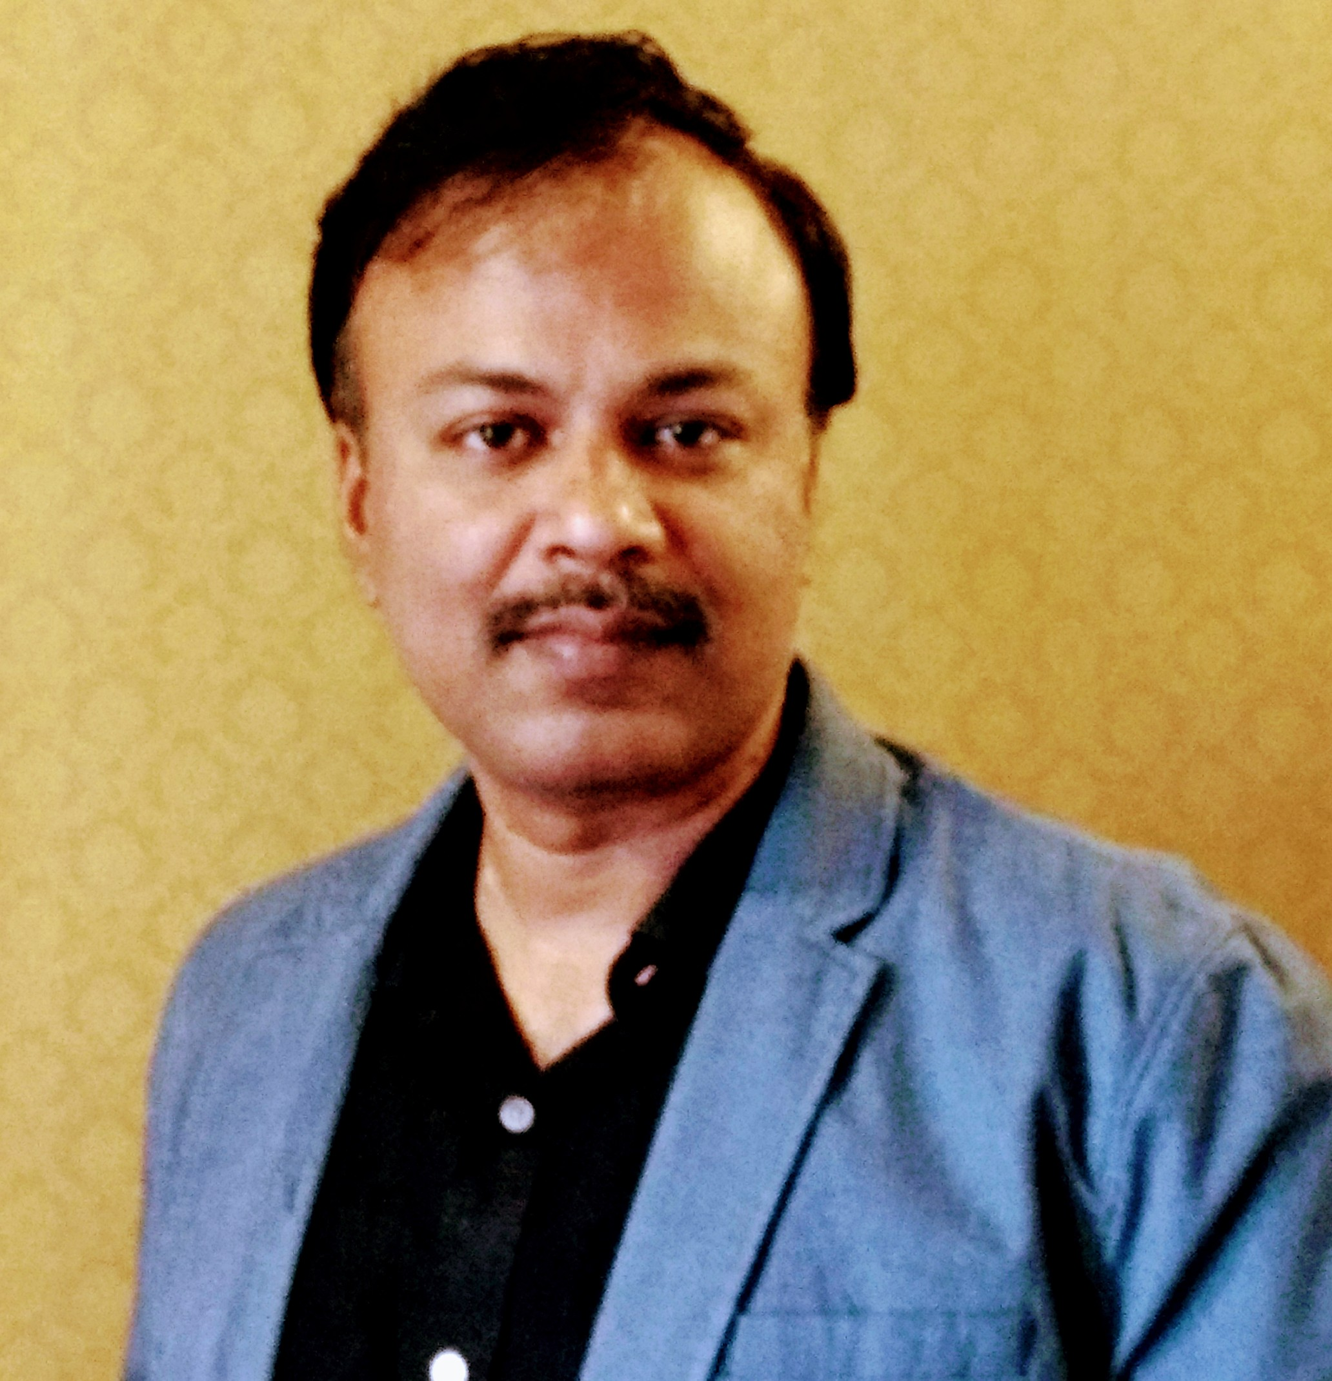
An industry veteran and IT business leader for transformation in the space of Polycloud, Platforms & Hyperscale Datacenters.
His 24+yrs industry experience in powering critical technology infrastructure and digital business initiatives serving Enterprise users, SaaS clients play a major role in enhancing the digital transformation journey of an organization.
His focus on inexorably advancing digital at Infosys has led to profound impact in adapting to make shift transitions on emerging technologies, building future/drawing strategy canvas and guiding execution, accelerating time to market and delivering top order commitments to various org stakeholders.
Mr Rajkumar
Vice President -IT, Infosys

Slide 12
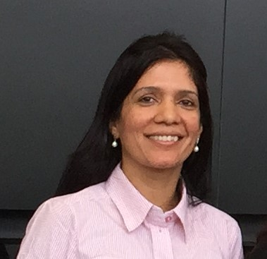
Ms Shalini Singh
Sustainability Head, India, APAC and EMEA VMware
Over 20 years of international experience in design, operations finance, engineering and project management, and corporate sustainability.
Shalini joined VMware, Bangalore in 2015 and leads sustainability function for India, APJ and EMEA.
Prior to VMware she worked for Stanford University leading carbon accounting, sustainable IT program and demand side energy management.
She has successfully driven strategic and tactical goals across functional teams in diverse sectors demonstrating influence, leadership, and unbridled passion. Shalini is a technologist at heart and a trained Architect with an MBA from San Jose State University.

Slide 13
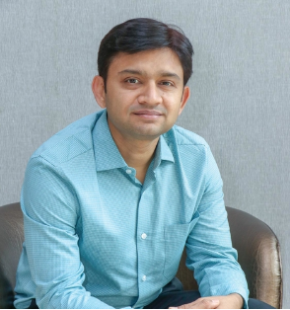
Mr Punit has over 18 years of experience in Green Building Design, Smart Buildings, Deep Green Retrofits, Industrial and Comfort cooling systems.
He has been with Infosys Infrastructure team since 2010. Punit is a chemical engineer with a post-graduation in marketing management.
Mr Punit works with the Infrastructure team at Infosys as Regional Head – Infrastructure. He led the Green Building Design work, Smart Campus practice, Retrofits practice, Operations Excellence for Infosys buildings and Campuses.
His focus is to make every campus at Infosys a smart, productive and sustainable campus, enhancing occupant and hence business productivity, while consuming minimum energy and resources.
Mr Punit Desai
Regional Head (Smart Spaces), Infosys

Slide 14
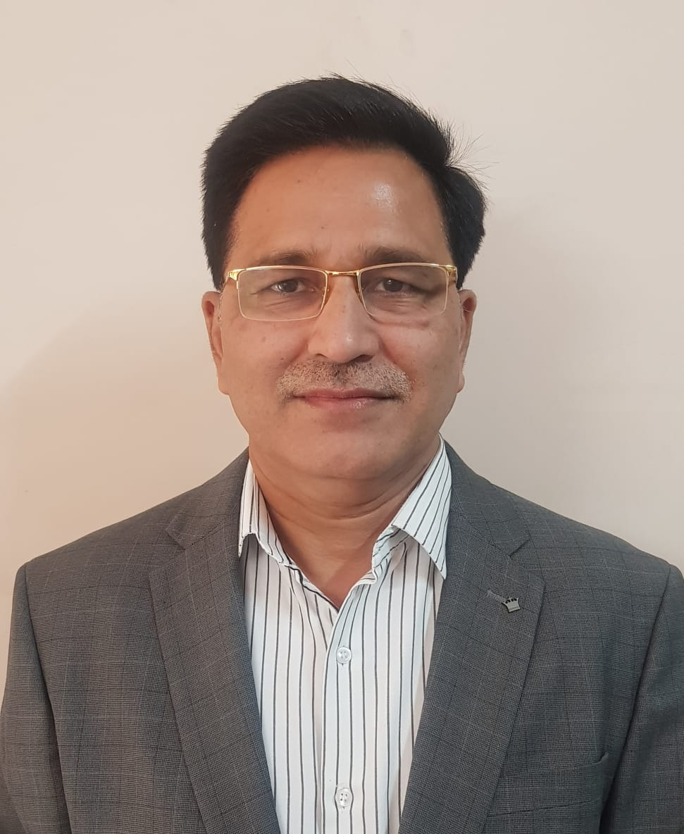
Mr Amit Kakkar
Technical Director, Dept of Info & Tech, Govt of Rajasthan
Mr Amit kakkar completed his B Tech in Electrical Engineering from MNIT Jaipur and M Tech in Energy from IIT Delhi .
He is the Additional Chief Engineer, Rajasthan PWD and is presently working as Technical Director, Department of information Technology and Communications, Jaipur
He is an IGBC AP, ECBC Master Trainer, Certified Data Center Professional ( CDCP) and BEE certified Energy Auditor.

Slide 15
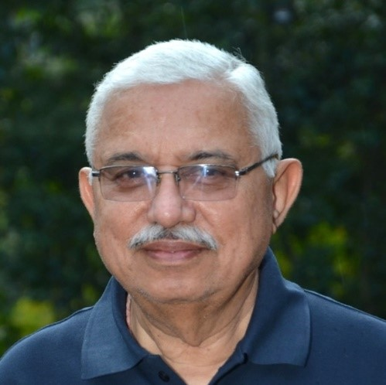
Mr Lalit Malhotra
Director – Technical,
Ensavior Technologies Pvt Ltd.
Mr Lalit Malhotra has industry work experience of over 40 years in Operations, Manufacturing & Fabrication, Quality Control, Sourcing, Project Execution and Research on varied product range relating to various industries including HVAC.
He is actively involved in various research topics in the field of UV, Thermal Storage and other engineering aspects.
He has hands on experience in Design, Application Engineering, Installation and Commissioning of Thermal Storage Systems.

Slide 17
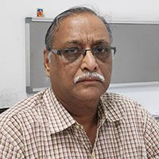
Mr P C Lohia
Sr. Vice President, HVAC
Reliance Industries Limited
Mr. Prakash Chandra Lohia is a Mechanical engineering graduate from BITS Pilani
He has more than 4 decades of rich experience and currently working as Sr Vice VP (Power & Utility) in Reliance Industries Limited.
He has handled various projects: Refinery, Petrochemical, synthetic filament, Internet Data Centre, Telecommunication and infrastructure projects.
Chairman, Taskforce (IGBC and LBNL, Chiller System)

Slide 18
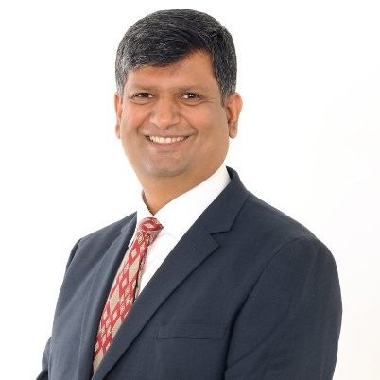
Mr Vivek Rajendran,
Director, Software Engineering
Dell EMC, Infrastructure Solutions
Mr Vivek Rajendran is the Director, Software Engineering at Dell EMC.
He has more than 25 years of experience in the DC industry
Chairman, IGBC and LBNL Taskforce – IT Hardware and Management

Slide 19
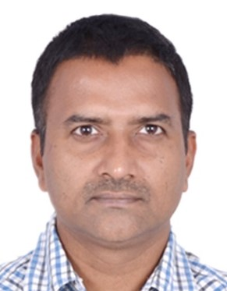
Mr Rajkumar Kambar
DC Manager Asia – Intel
Rajkumar is a Datacenter Manager & Planner – holds Bachelor of Science in IT from Mysore University.
He joined Intel in 2005 and working in Datacenter operations, has total industry experience of 25 years.
Raj’s role is to manage Datacenter Operations & Capacity planning for all of Intel’s Data Centers across Asia.
He is a subject matter expert in Datacenter Facilities & IT technologies.
He works with different stakeholders across IT & Facilities to ensure that Intel’s DCs are running at optimal efficiency and cost. Raj has written various white papers on datacenter efficiencies and retrofit best practices.

Slide 20
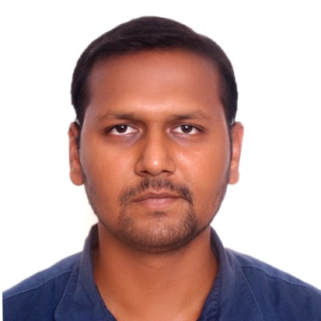
Mr Shubham Agarwal
Manager, Infosys
Mr Shubham Agarwal is managing Pan India Digital operations of Infrastructure in terms of Environment, Health and Productivity initiatives.
Providing focused approach to different location : Data analytics and providing strategic planning for proper execution.
His primary role at Infosys includes :
Optimizing water and energy usage. Improving solar, Irrigation and STP system efficiency.
HVAC design and operation optimization.
Providing inputs for enhancing and supporting Business Continuity.
Handling Data center project for improving DC infrastructure and improving Infra IOT platforms for better Data analytics and usage.

Slide 21
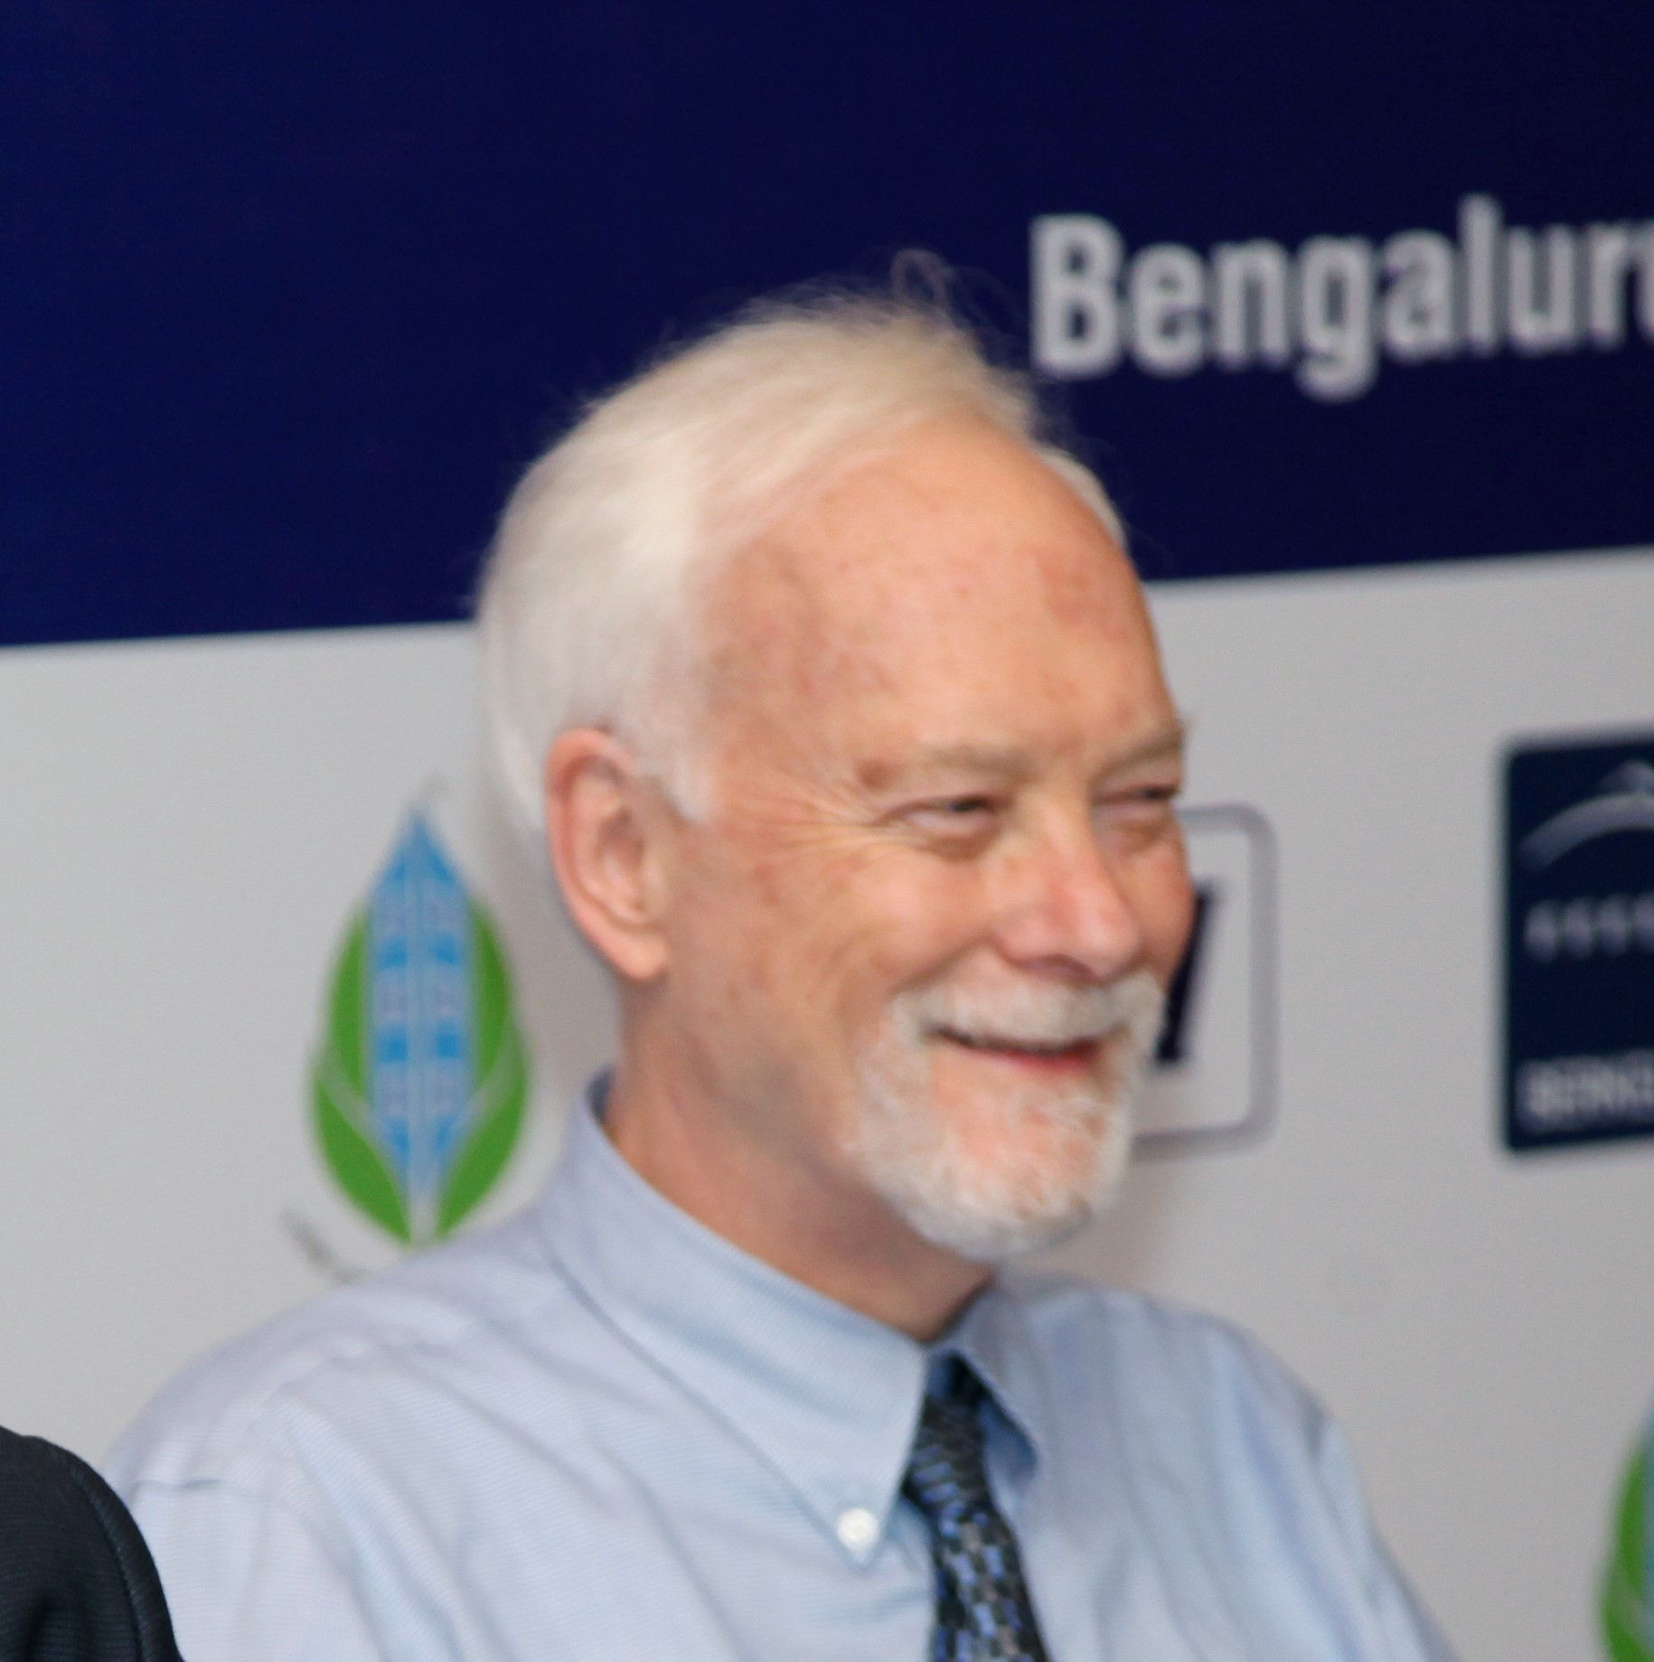
Mr Dale Sartor
Staff Engineer,
Lawrence Berkeley National Laboratory (LBNL) USA
Dale Sartor, P.E., is a staff scientist/engineer at LBNL where he focusses on building efficiency technology applications.
He leads projects to develop and transfer new technology and stimulate the use of underutilized technology.
He has over forty years of professional experience in energy efficiency and renewable energy applications including ten years as a principal of an architecture and engineering company, and seven years as the head of LBNL’s In-House Energy Management Program.
Currently Mr. Sartor is focused on RD&D on energy efficiency in buildings for high tech industries (i.e. laboratories, cleanrooms, and data centers)

Slide 22
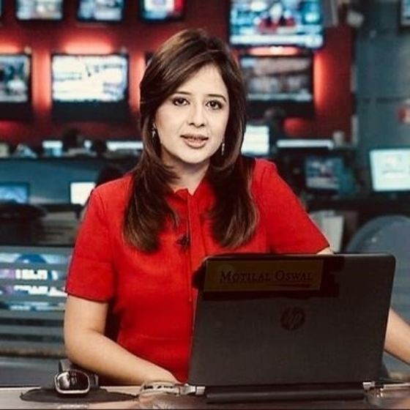
Ms Nisha Poddar
Market Anchor & Editor -M&A,
CNBC-TV18
Market Anchor & Editor - M&A
Organizatoin :CNBC-TV18
Journalist for over 15 years.

Slide 23
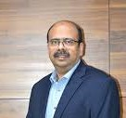
Interaction with Data Center Industry Stalwart
Ms Nisha Poddar
Market Anchor & Editor –M&A, CNBC-TV18
Moderator:
Mr Syed Mohammed Beary
Chairman, IGBC Bangalore Chapter & MD Bearys Group
Mr Dale Sartor
Staff Engineer,
Lawrence Berkeley National Laboratory (LBNL) USA
Mr Sharad Sanghi
CEO – Global Data Centers and
Cloud Infrastructure (India),
NTT Ltd.

Slide 24
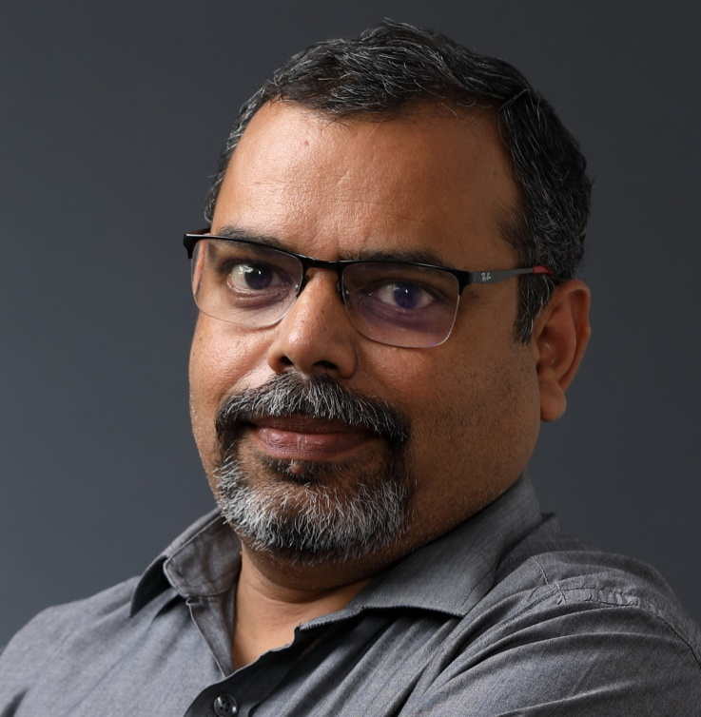
Mr Bhawesh Kumar
Associate VP, Infosys
Associate Vice President & Regional Head - Facilities, responsible for entire Corporate Facilities across locations and Global Head of Facilities operations at IBPM (Infosys Business Process Management )
He is also the Vice President and Executive Committee Member of Electronics City Industries’ Association.
25 years of experience In Infrastructure and Facilities in the Phase of Planning along with the Facilities head in the Business and strategy Planning.

