Slide 1
Case study – Infosys Data Center
Aspiration, Learning and collaboration

Slide 2
Infosys-Being An Environmental steward
1st Indian corporate to receive the UN Global Climate Action Award in the ‘Climate Neutral Now’ category at COP25 n December 2019 for our carbon neutral program.
In our journey to towards a carbon-neutral future, ANNUAL PER CAPITA SCOPE 1 AND 2 EMISSIONS (tCO2e) 70.07% reduction between fiscals 2008 and 2020.
With all our efforts, we could limit the increase in electricity consumption to 20%, while our employee strength has grown by 166%,as compared with the baseline year of 2008.
44.3% of total electricity procured for India operations from renewable resources

Slide 3
IGBC & LBNL
Helped us in collaborating with industry experts
Supported us during the setbacks and helped us in finding solutions
Motivate us to write the case study on our aspiration and learning path
Supporting and motivating us to achieve our sustainability goals.
Partners in our achievements

Slide 4
Project Overview
Design with a PUE of 1.12
High server room temperature design @ 27 deg C
Warm water design @ 23 deg C
Passive rear door heat exchanger (RDHx) design to bring CHW near to the load
Building management system for monitoring, optimization and reliability. Rack level monitoring of temperature and Power utilization.
Tier 3 design for reliability

Slide 5
Project Design
Small Capacity of 300 KW but with an ambitious target to achieve PUE of 1.12
Design to use the free ‘evaporative’ cooling available in moderate climate of Bangalore
Design to minimize the compressor-based cooling because of water temperature requirement of 23 deg C.
3 mode of operation:
Mode 1 – Cooling tower based(Free cooling) (PUE-1.12)
Mode 2 – Water cooled Chiller (PUE- 1.18)
Mode 3 – Air cooled chiller based.(PUE – 1.4)
High Equipment efficiency complying to ECBC Level 3 of Data center on individual basis.

Slide 6
Operational Challenges
Air mixing issues due to mix IT asset configuration and back pressure of Passive RDHx.
Higher approach than design and hence lower Water temperature requirement of 19 deg C.
Due to low temperature requirement, free cooling can not be utilized properly.
Water cooled chiller is associated with other campus buildings for comfort cooling and running intermittently only in morning office time.
Due to challenges in Mode 1 and Mode 2 of operation, maximum operation shifted to Mode 3 i.e air cooled chiller.

Slide 7
Solutions under implementation
Using the robust BMS system, granular data is analyzed and the racks causing the maximum air mixing is being identified.
Customized blanking panels as per IT asset design to reduce air mixing (suggestion given by Mr. Lohia).
Testing of Active RDHx system is going on to reduce the mixing of hot and cold air.
Retrofit and conversion of an adjoining data center to ‘high temperature’ chilled water of 15 deg C to increase the continuous load on water cooled chiller.

Slide 8
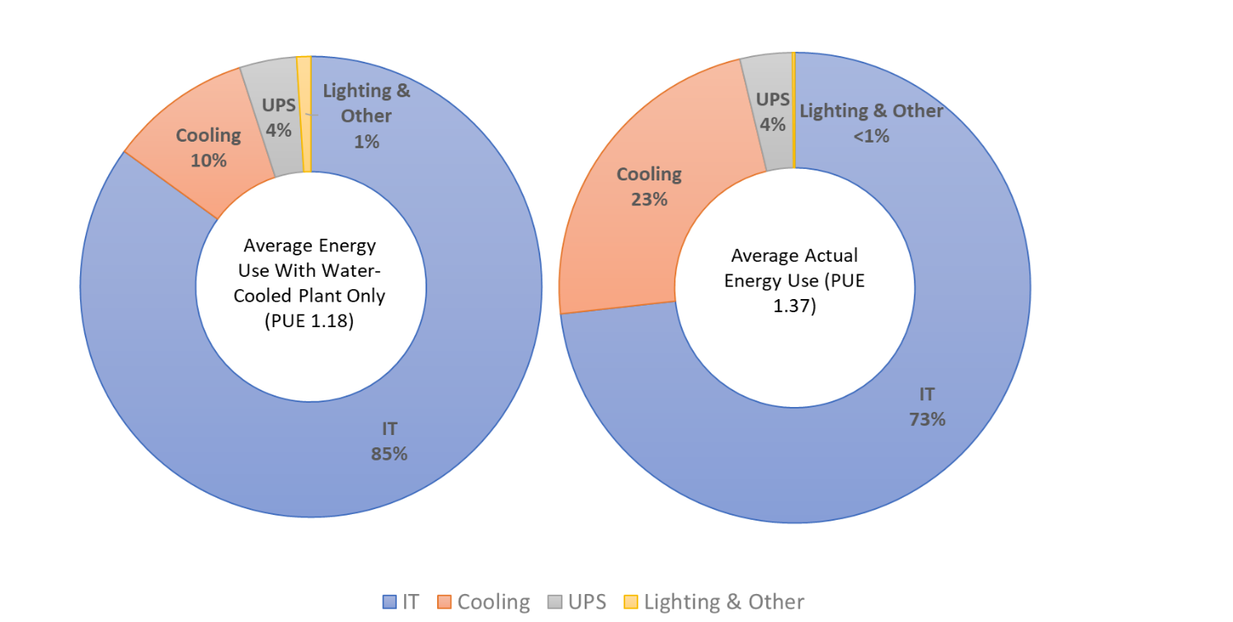
Water cooled chiller PUE vs Existing PUE
50% reduction in infrastructure energy can be achieved by shifting from Air cooled chiller to water cooled chiller.

Slide 9
Learning
Project and Operation has their own set of challenges.
Co-ordination between multiple stakeholders/teams reduces the challenges.
Out of box approach can solve the problem in a creative way.
3 equal partners for Energy efficiency in Data centers are:
The Design and project team
The Infrastructure operation team
The IT team

Slide 10
Collaboration
Dedicated team of all three stakeholders i.e IT team, Infrastructure operation and Project team has been formed to look at the opportunities in improving the Efficiency of Data center.
Reduces the time required for execution
Also reduces the futuristic operational challenges.
Constant feedback of all the team is getting analyzed regularly for carrying out the best execution plan.
Agile model of execution rather than windfall model of execution.

Slide 11
Aspire to achieve higher
Thank You

