Slide 1









Delivering Business Value
through
Better Aligning Facility & IT
NK Singh
Senior Director, Business Development - Greater India

Slide 2



Business Value
Fast & Flexible | Reliable | Sustainable | Efficient | Investment Protection & ROI

Slide 3
Data Center Layers
Design
Application Layer
Implementation
Middleware Layer
OS Layer
Policies, Process & Procedures
Security
Server/Storage Layer
Network Layer
Building Layer

Slide 4


Application Resiliency planning used to be Simple
Enterprise
Single Architecture
Simple Design
Direct Ownership
Clear Authority
Managed User QoS
Application
Data
Network
Data
Center
Notes:
Management in many enterprises is still designed to support this environment
Or tower functions , without cross functional design

Slide 5
Application Resiliency planning used to be Simple
Enterprise
Application expansion into Colocation and Edge locations or & Application functionality migrating to and written for Cloud…
Application
Data
Data
Center
Colo/Edge
Network
Cloud
Notes:
Built in cloud function, ability support rapid or uneven workload growth, and built-in HA options have made cloud a popular alternative

Slide 6
Application Resiliency planning used to be Simple
Enterprise
Multiple Architecture
Complex Design
Indirect Ownership
Delegated Authority
Tracked User QoS
Data
Application
Resiliency Success means providing availability across this diverse and complex environment …
Data
Center
Colo/Edge
Network
Cloud
Notes:
Built in cloud function, ability support rapid or uneven workload growth, and built-in HA options have made cloud a popular alternative

Slide 7
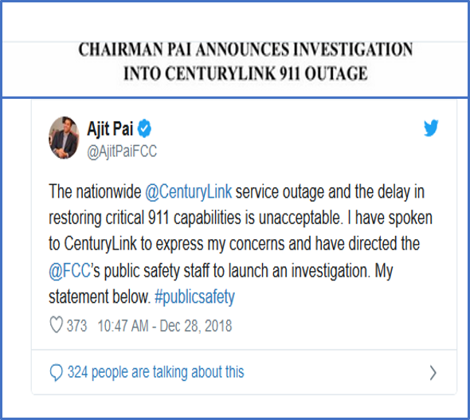

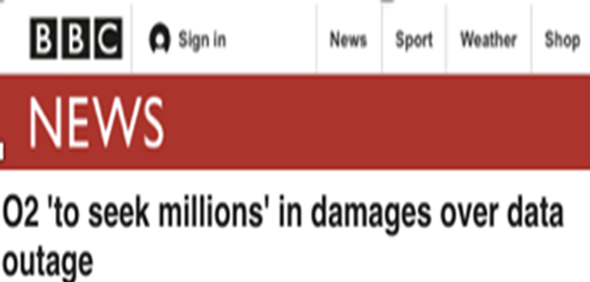
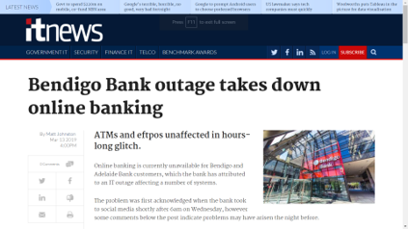



Outages Make the Headline News and have REAL costs and sometimes generate lawsuits…

Slide 8
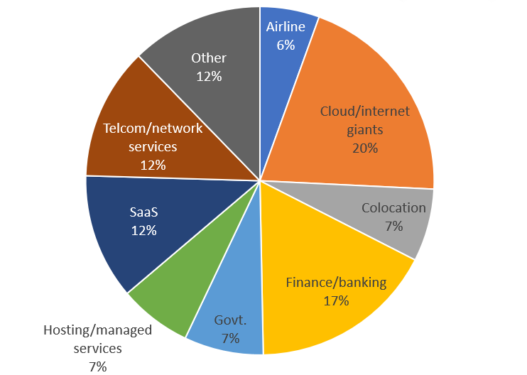
Outages are Common & Rampant
Network and IT now outstrip power as the primary cause of publicly recorded outages
Facilities causes, together, still account for the most reported outages (32%)
Fire and fire suppression problems account for 7% of outages
Cloud/internet giants not immune to failure….
Professional service providers account for most reported outages
Finance and airlines disproportionately disrupted by IT failures…
Source: Various online news sources, Uptime Institute Research, January 2019

Slide 9
Key Success Factor
Process
Products
Partner
People
Number
Qualification
Experience
Skills
Project Process
  Plan
  Milestones
  Deliverables
Operational Process
  SOP
  EOP
  MOP
  KPI
  SLA
Competency
Experience
References
Financial Strength
Technology
Efficiency
Reliability
Scalability
Serviceability
Standard & Best Practices

Slide 10
Start with End in Mind

Slide 11

DC Facility Management - A Comprehensive Approach
Reviews
KPI Management
Reporting
Escalation Management
Roles & Responsibilities
24/7 Monitoring & Alarm Handling
Vendor Management
Change Management
Incident Management & Resolution
PM Management
Governance
Data Centre
Operations
Comms
Cooling
People &
Organization
Power
Regular IST Programs
Problem Management (RCA)
DR and Risk Management
Utilization monitoring & planning
Forecast management
Refresh & upgrade planning
Floor space planning
Data Centre
Availability
Data Centre
Capacity
Culture
Premises
Fire
AUTOMATION
Methods
Processes &
Procedures
Systems &
Tools
Joint Quality
&
Culture
Documented Quality Management System
Quality Audits
Quality Improvement Initiatives
Energy & infrastructure Audits
Industry ratings
Optimization Planning
Tariffs, load profile, power factor and harmonics management
Data Centre
Optimisation
DCIM/BMS
Security
Whitespace
Technology
Strategy
Customer ownership Strategy
Advisory & Worskhops

Slide 12
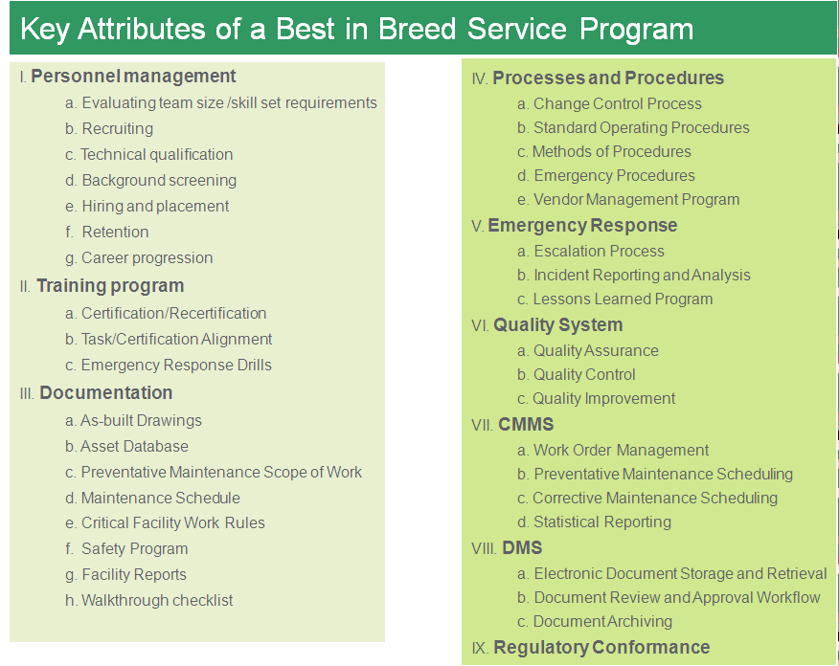
Comprehensive Operation & Management Program
KPI’s
Uptime
  Critical Systems
  Essential Systems
  Support Systems
Performance
  Maintenance
  Staffing
  Security
  Emergency Preparedness
  Emergency Response
  Safety
Quality
  Procedure
  Quality Control
  Quality Improvement
  Training
  Process Improvement
Reporting
  Operational
  Notification
  Financial

Slide 13
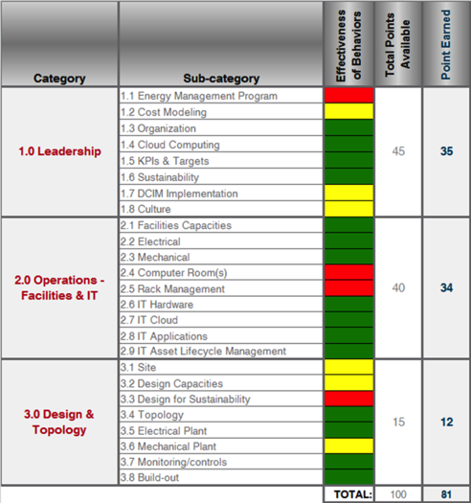
Hybrid IT
Efficient IT
Orientation call
Coordinate tasks and schedule; review requirements and expectations for on-site visits
On-site review
At each data center, consultants review existing information and tools in use for validation against the EIT criteria
Leadership interview focused on specific EIT criteria and debrief of initial key findings from the data center visits
Post-site-visit teleconference
Deliverables
Overview: score and key findings noting significant accomplishments and areas for improvement
Detailed findings identify positive site practices and areas that do not meet EIT protocol
Actionable recommendations on how to improve IT efficiency
Award letter, electronic stamp, and physical plaque

Slide 14
Recommended Next Steps…
Enhance the competency of the Team with Training & accreditation courses
For Data Center in Conceptual Phase
  Go through Three stage Certification Process
  Take Supplementary Services wherever necessary
For Existing Data Centers:
  Data Center Risk Assessment
  Tier Gap Analysis
  Based on the Outcome of Tier Gap Analysis or DRA, decide on next steps whether:
    Retrofits
    Go for three stage certification
    Or Management & Operations Stamp Approval
Use Supplementary or Advisory Services wherever required
Please Leverage Top Ten Consideration while Preparation of Design - Build RFP of Data Center

Slide 15
Thank You!!!!
nksingh@uptimeinstitute.com
Mobile: +91-9686926201
Notes:
15

